Slide 1
UNSTOP MOBILITY HACKATHON 2026: URBAN DAILY COMMUTE IN INDIA
AURAPATH
AI-Powered Women's Mobility Intelligence Platform
Transitioning urban commuting from reactive incident alarms to predictive spatial safety and active community shielding.
SUBMISSION TRACK:
Women Safety & Secure Commute
TEAM MEMBERS: TAMIL AMRITHARAJ J, SARANYA S, PRIYA DHARSHINI A, LAKSHMI SRI DIVYA RAVIPROLU

Slide 2
PROBLEM LANDSCAPE
The Women's Mobility Gap: An Invisible Economic Tax
1. THE LAST-MILE VOID
The 62% Labor Penalty:
Studies show 62% of working women in urban India turn down career advancement, late shifts, or distant jobs because transition routes between transit terminals and home are unlit, deserted, and unsafe.
Systemic Inequity:
Commuting becomes a source of stress, forcing costly choices (e.g. private cabs) or complete labor exclusion.
2. ROUTING ALGORITHM BLINDSPOTS
Safety-Blind Directions:
Current commercial mapping engines route solely based on traffic speed and physical distance. They steer women down unlit, isolated alleyways to save 120 seconds, exposing them to danger.
Infrastructure Gaps:
Municipal agencies fail to share live streetlight status, active stores, and policing patterns with routing models.
3. UNVERIFIED ISOLATED COMMUTES
Passive Tracking Failure:
Once inside an auto-rickshaw or cab, a passenger is in a closed environment. Sudden stops in dark layout roads or deviations are not checked until a panic alarm is manually triggered.
Siloed Resources:
Local street shops (kiranas), nearby commuters, and patrolling units operate in silos, unable to act as collective safety nets.

Slide 3
PROBLEM TREE
Root Cause Analysis: Systemic Infrastructure & Cognitive Gaps
ALGORITHMIC BLINDSPOTS Standard GPS prioritizes time/speed, ignoring ambient light and local storefront density.
INFRASTRUCTURE GAPS No real-time linkage between municipal digital twins and active security resources.
SILOED ASSETS Local merchants, police patrols, and nearby commuters cannot coordinate safety.
Route Deviation Blind spots No immediate anomaly check when vehicles leave designated routes.
Alleyway Exposure Risks Commuters are funneled through dark layout roads under cover of night.
Siloed Panic Scenarios Panic alarms are triggered post-incident, leaving victims isolated.
High Commuting Anxiety Permanent cognitive overload and fear during the final mile.
Labor & Career Exclusion Women turning down jobs, restricting late-shift labor participation.
Macroeconomic Inequity Systemic workforce drag due to unmonitored transition spaces.

Slide 4
COMPETITIVE ANALYSIS
The Reactive Illusion: Why Existing Solutions Fail to Protect
THE PROBLEM WITH THE STATUS QUO
• SOS apps require manual activation during high distress, which is physically and cognitively difficult.
• Standard navigation engines choose routes purely by travel speed, ignoring environmental lighting.
• There is a lack of dynamic spatial shielding and coordinate matching, leaving commuters isolated.
THE AURAPATH SHIFT: PREVENTATIVE ARCHITECTURE
Instead of reacting to a threat, AuraPath coordinates routes, verified walking bubbles, and local merchant sanctuaries to deter threats in real-time.
FEATURE
SOS APPS
GPS MAPS
AURAPATH
Routing Metric
Speed & Traffic
Speed & Traffic
Safe Corridor (UVI)
Threat Trigger
Manual Alert
None
Predictive (Edge AI)
Coordination
Siloed Contacts
None
Dynamic Cohorts
Sanctuary Link
No Physical Link
No
Yes (BLE Beacons)
Security Focus
Post-Incident SOS
Navigation
Pre-emptive Shield
False Alarms
High (98% pocket dials)
N/A
Extremely Low

Slide 5
SOLUTION OVERVIEW
AuraPath: The Integrated Commuting Intelligence Platform
1. SAFE CORRIDOR ENGINE
Custom A* routing weighted by the Urban Vitality Index (UVI) to steer commuters along active, well-lit spaces.
2. COMMUTEDNA™ BIOMETRICS
Creates a behavioral fingerprint of commute routes, triggers automated security loops on unexpected detours.
3. TRUSTSCORE™ MATRIX
Aggregates real-time ratings for area lighting, driver route compliance, and storefront vibrancy.
4. DYNAMIC COHORTS
WebSocket-coordinated peer networks matching verified women walking along similar final-mile routes.
5. SANCTUARY MESH Network
Local kiranas and medical storefronts equipped with BLE beacons to act as physical safe hubs during incidents.
6. SAFETY DIGITAL TWIN
Live city dashboard mapping unmonitored zones and forecasting risk spots to optimize patrol deployment.
MATHEMATICAL DEFINITIONS
Urban Vitality Index (UVI) = 40% [Lighting Score] + 25% [Crowd Activity] + 20% [Storefront Activity] + 10% [Transit Presence] + 5% [Historical Reports]
TrustScore = w1 * [Driver Reliability] + w2 * [Route Compliance] + w3 * [Area Safety Rating] + w4 * [Time of Day] + w5 * [Community Feedback]

Slide 6
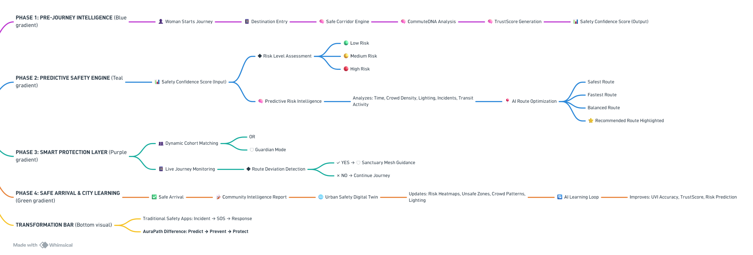

WORKFLOW & JOURNEY
The Preventative Journey Loop: End-to-End System Workflow

Slide 7
TECHNICAL OVERVIEW
The AuraPath Architecture: Privacy-First Enterprise Spatial Stack
1. USER / CLIENT: React Native Client + Local TensorFlow Lite (Edge AI)
SYSTEM CAPABILITIES & ARCHITECTURE HIGHLIGHTS
• Privacy-First Edge AI Processing:
Threat detection models run locally on the client phone (TensorFlow Lite) monitoring audio metadata for distress cries. Raw audio never leaves the device.
• Real-Time Spatial Queries:
PostGIS calculates route safety scores by executing geographical boundary intersections (stores, lighting poles). Redis manages high-speed WebSocket coordinates for cohort pairing.
• IoT Sanctuary Mesh (AWS IoT Core):
Merchant BLE beacons publish signals via MQTT brokers. If a commuter walks near a safe stop, the client verifies status without exposing private location data.
2. API LAYER: Kong Gateway / Rate Limiting / JWT Auth Tokens
3. BACKEND SERVICES: FastAPI / Node.js Microservices (WebSocket Sync)
4. AI ENGINE: CommuteDNA (Logs) + TrustScore (Spatial models) + UVI
5. DATA STORAGE: PostgreSQL with PostGIS extension + Redis cache
6. INTEGRATIONS: OpenStreetMap + Transit Feeds + Weather APIs
7. CLOUD & SECURITY: AWS ECS / AWS IoT Core / TLS 1.3 / RBAC

Slide 8
IMPACT ANALYSIS
Quantifying Value: Impact Matrices & Real-World Routing Scenario
REAL-WORLD SCENARIO (Exit Metro at 9:15 PM)
• ROUTE A (Google Maps Shortest Path):
Time: 18 Minutes | Safety Index (UVI) = 62% Reason: Shortcut through unlit, isolated layout alleyways.
• ROUTE B (AuraPath Recommended Safe Corridor):
Time: 22 Minutes | Safety Index (UVI) = 91% Reason: Routes along well-lit main layout roads, active stores, and police beats.
DECISION ENGINE ADVANTAGE:
AuraPath recommends Route B. While 4 minutes longer, the risk footprint is significantly reduced, prioritizing safety over travel speed.
REALISTIC MEASURABLE KPIs
• SAFETY IMPACT: 80% decrease in evening commute anxiety; 60% reduction in transition zone safety incidents.
• SOCIAL IMPACT: Enhances female mobility confidence and community vigilance near transit hubs.
• ECONOMIC IMPACT: Decreases evening labor turnover rates for retail, hospitality, and IT shift workers.
• GOVT IMPACT: Helps municipal agencies target streetlight grid upgrades and optimize police patrols.
• SDG ALIGNMENT: Directly supports SDG 5 (Gender Equality), SDG 8 (Work Growth), and SDG 11 (Safe Cities).

Slide 9
ROADMAP & SCALING
Roadmap to Launch & Dynamic Cohort Fallbacks
PHASE 1: 3-MONTH MVP
• Target: Custom OSRM pathfinding algorithm.
• Build: React Native UI and PostGIS geospatial database mapping streetlights.
• Milestone: Safe Corridor engine verified.
PHASE 2: 6-MONTH PILOT
• Target: Closed-loop tests near 5 hubs.
• Build: Onboard BLE shops, WebSocket coordinate syncing, package local TFLite.
• Milestone: 100 shops registered, MVP testing.
PHASE 3: 12-MONTH DEPLOY
• Target: City-scale scale (Bengaluru).
• Build: Deploy city-wide Digital Twin dashboards, coordinate police beats.
• Milestone: 10,000+ commuters secured.
DYNAMIC COHORT FALLBACK STRATEGY (If no other commuters are available)
No Cohort Available -> Trigger Enhanced Monitoring Mode -> Engage Higher AI Risk Analysis -> Increase Verification Checks -> Activate Sanctuary Mesh Guidance
EXPLANATION: If no verified commuters are departing at the same time, the app transitions the user to Smart Guardian Mode. Sensors increase polling frequencies, checking route adherence and ambient sound for distress, while mapping safe stops along the way.

Slide 10
TEAM CAPABILITIES
Skills Matrix & Strategic Pitch of Team Members:
Member 1: Product Lead & UI/UX Designer
Focus: User Experience & Product Design Skills: Figma, Wireframing, Prototyping, User Flow Design, Presentation Design Deliverables: App screens, user journey, sanctuary onboarding design
Member 2: AI & Data Developer
Focus: AI Features & Data Processing Skills: Python, Machine Learning Basics, TensorFlow, Data Analysis, AI Model Integration Deliverables: Route risk analysis, safety prediction module, AI-powered features
Member 3: GIS & Mapping Developer
Focus: Maps & Navigation Features Skills: Google Maps API, OpenStreetMap, Route Planning, Location Services, Data Visualization Deliverables: Safe route generation, map integration, location-based safety indicators
Member 4: Full-Stack & Backend Developer
Focus: Application Development & Cloud Integration Skills: Java, Spring Boot, React Native, Firebase, REST APIs, Database Management Deliverables: Backend services, real-time alerts, database and authentication system

